Slide 1
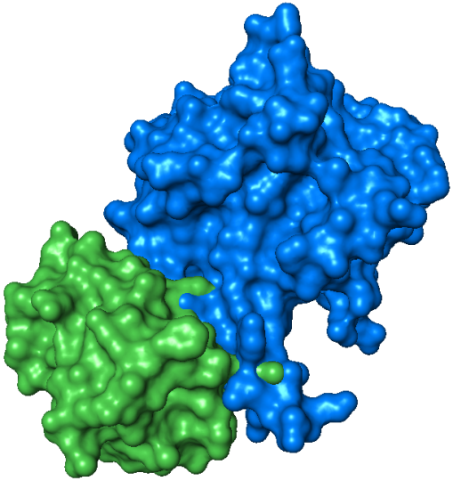
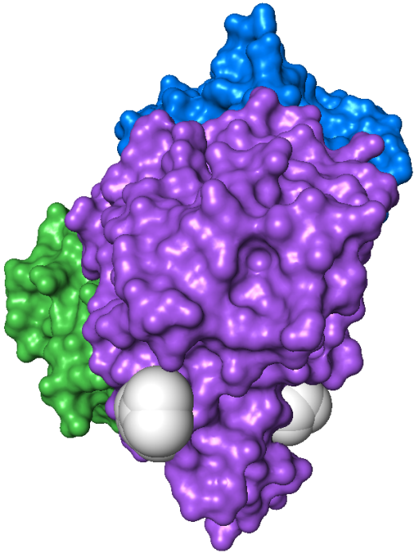
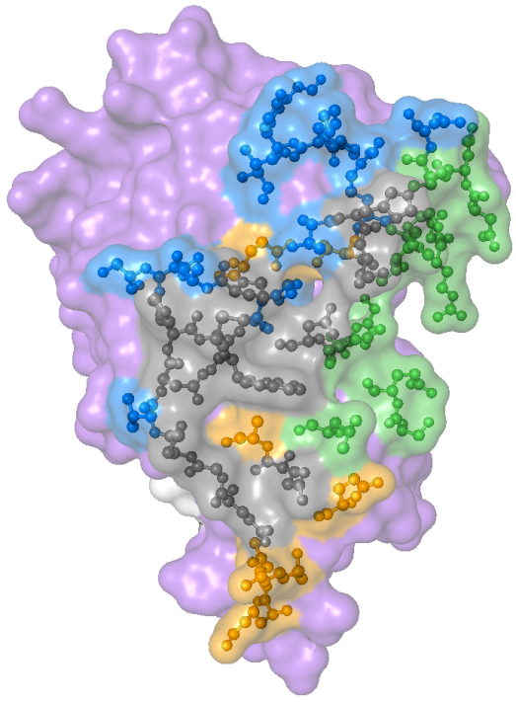
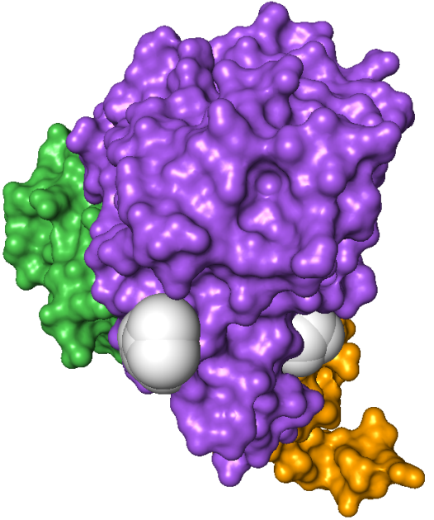
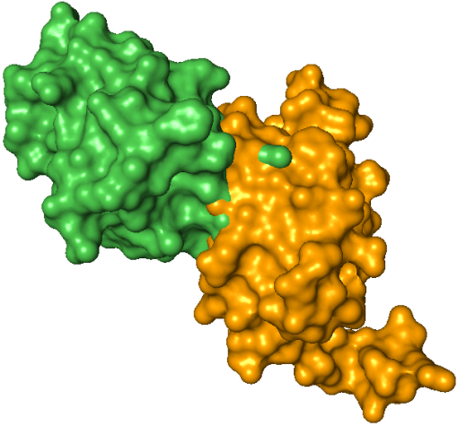
NanE
NanE
HPr
Binding sites on NagB:
HPr
NagB
NagB
HPr can only bind
NanE or U-PII
M223
D165
N221
W224
HPr
W224
N
C
NagB
HPr
Interface shared by NanE and U-PII
U-PII
Inter-subunit contacts
Inter-trimer contacts
Key residues are indicated

